Slide 1
HMH Science Dimensions
Biology
Unit 7: Genetics and Heredity
Notes:
The learning experiences in this unit prepare students for the mastery of
Performance Expectations
LS3-1 Ask questions to clarify relationships about the role of DNA and chromosomes in coding the instructions for characteristic traits passed from parents to offspring.
LS3-2 Make and defend a claim based on evidence that inheritable genetic variations may result from (1) new genetic combinations through meiosis, (2) viable errors occurring during replication, and/or (3) mutations caused by environmental factors.
LS3-3 Apply concepts of statistics and probability to explain the variation and distribution of expressed traits in a population.
ETS1-3 Evaluate a solution to a complex real-world problem based on prioritized criteria and trade-offs that account for a range of constraints, including cost, safety, reliability, and aesthetics, as well as possible social, cultural, and environmental impacts.

Slide 2

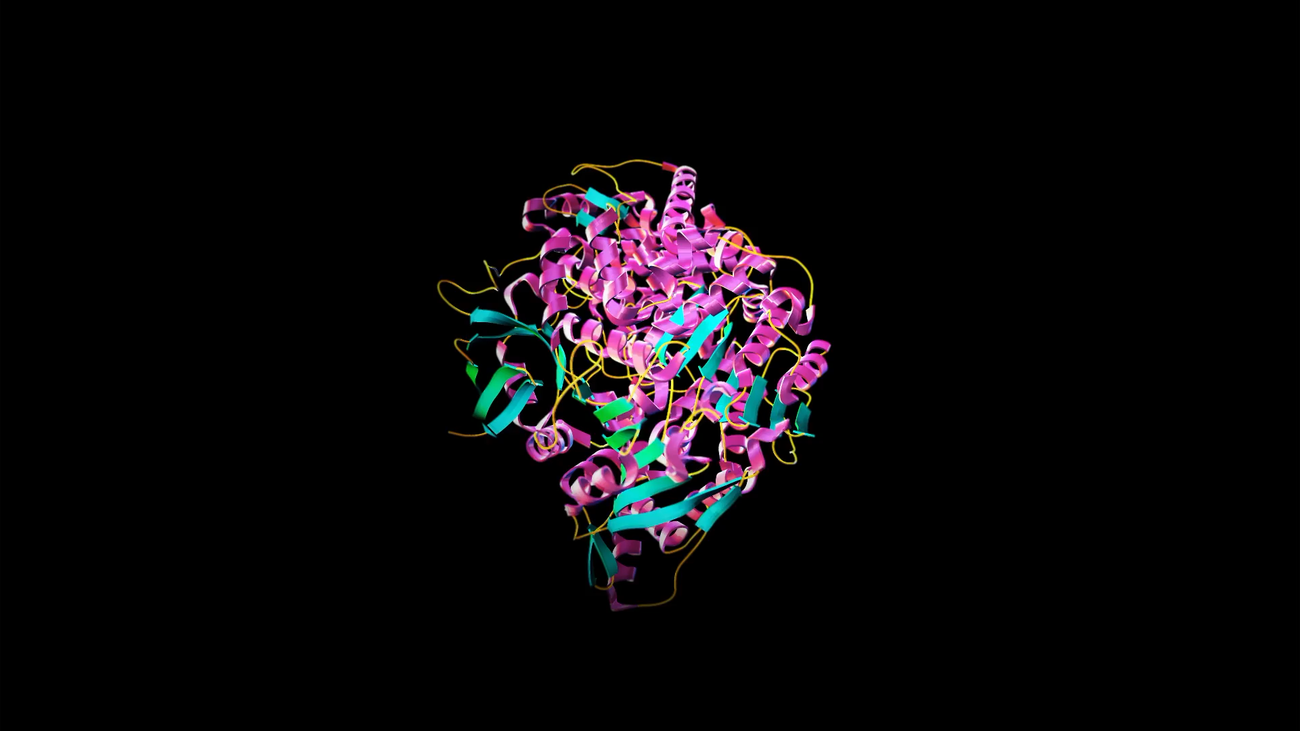
Genetics and Heredity
Unit 7
Proteins like Cas9 can be used to edit DNA.

Slide 3



Genetics and Heredity.
Unit 7
Why do you think siblings don't look exactly the same if all of their DNA comes from the same mother and father?
Children inherit traits from each of their parents.

Slide 4
Driving Questions
Unit 7
As you move through the unit, gather evidence to help you answer the following questions:
How are traits passed from parents to offspring?
Why do the offspring of two parents all look different from each other?
How does diversity in traits arise over generations?
How can we determine the probability that an organism's expressed version of a trait will be passed to its offspring?
Can scientists alter the genetic material of other organisms? How might humans use this ability?

Slide 5

Unit Project
Unit 7
Investigating the Heredity of Disease
Many traits and conditions can arise from either genetic or environmental causes. Explore the heredity of Huntington's disease. Based on your analysis, determine the likely cause or causes of Huntington's disease and the role that genetic or environmental factors may play.

Slide 6
Unit Review
Unit 7
Synthesize the Unit
Make a concept map, other graphic organizer, or outline using the Study Guides you made for each lesson in this unit. Be sure to use evidence to support your claims.
When synthesizing individual information, remember to follow these general steps:
Find the central idea of each piece of information.
Think about the relationships among the central ideas.
Combine the ideas to come up with a new understanding.

Slide 7
Image Credits
Unit 7
animation of CRISPR video ©Science Source; family ©pixelheadphoto digitalskillet/Shutterstock

